Slide 1

Video Anomaly Detection in Deep Learning Domain: Computer Vision
Student Name: Vineeth Goud Maddi (811196971)

Slide 2
Table of Contents
1.Video Anomaly Detection in Deep Learning
2.Literature Review
3. Applications of Anomaly Detection in Current Research
4. Potential Future Developments

Slide 3

video anomaly detection in Deep Learning
Surveillance videos can capture a variety of realistic anomalies. Using this data one can learn anomalies by exploiting both normal and anomalous videos.
Example – Real time monitoring systems.
To track people's typical motion and identify deviations from that motion as anomalies, beyond just differentiating between aggressive and nonviolent patterns.
Scope:
Automated detection of unusual events, such as accidents, criminal activity, or unlawful behavior, is beneficial. Since anomalous events are uncommon and come in a variety of forms, manually recognizing them can be time-consuming and arduous, especially for lengthy video sequence.

Slide 4
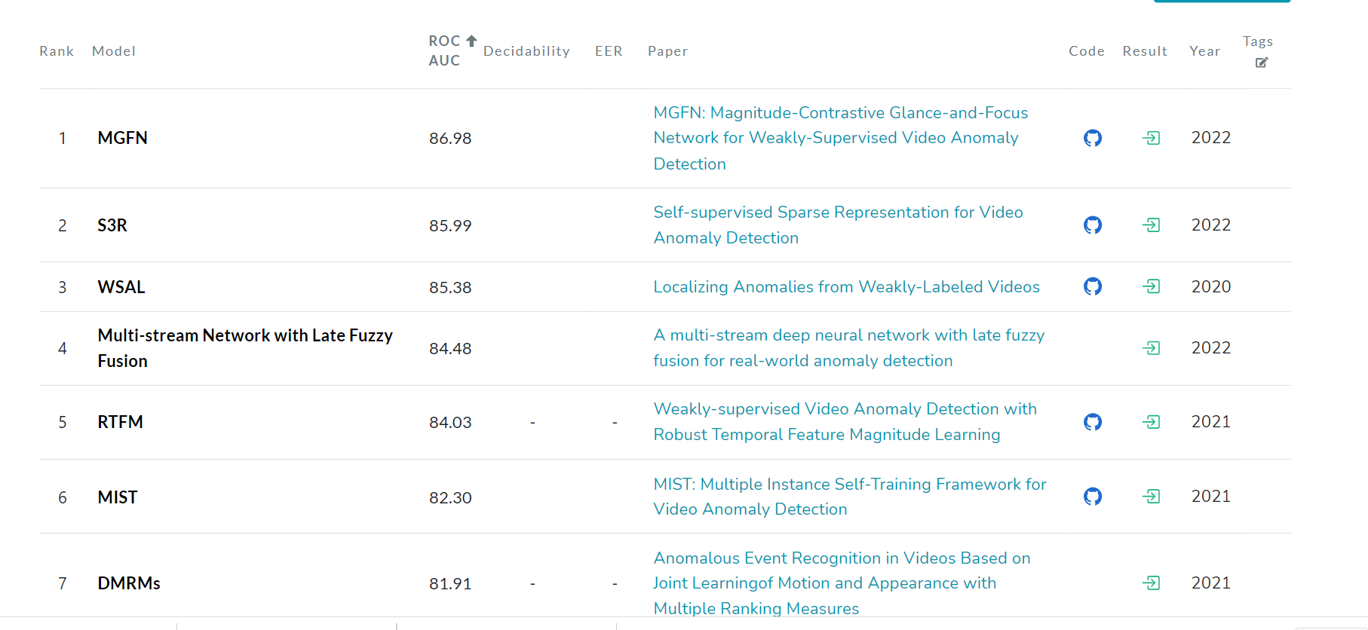
State-Of-the-Art Techniques list in VAD (Video Anomaly Detection):

Slide 5

Literature Review:
Several methods forego tracking to learn global motion patterns through histogram-based techniques, topic modeling, and motion patterns because it is difficult to collect solid tracks in these situations.
Several authors come up with different model patterns to detect anomaly in videos.

Slide 6
Techniques
S3R - Self-supervised Sparse Representation for video anomaly detection
RTFM – Robust Temporal Feature Magnitude Learning
MIL – Multiple Instance learning.

Slide 7

Highlights
An MIL solution to anomaly detection by leveraging only weakly labeled training videos. They utilize MIL ranking loss with sparsity and smoothness constraints for a deep learning network to learn anomaly scores for video segments.
Experimental results on our new dataset show that our proposed method achieves superior performance as compared to the state-of-the-art anomaly detection approaches.
a self-guided attention boosted feature encoder that aims to automatically focus on anomalous regions in frames while extracting task-specific representations.
Robust Temporal Feature Magnitude learning (RTFM), which trains a feature magnitude learning function to effectively recognize the positive instances

Slide 8
Drawbacks
The requirement of providing these precise temporal annotations is relaxed by MIL. MIL does not know the exact temporal positions of abnormal events in videos.
Instead, all that is required are video-level labels showing the presence of an abnormality throughout the entire video.
By temporally localizing anomalous portions inside anomalous movies, the Weakly Supervised Anomaly Localization (WSAL) approach seeks to locate anomalous phenomena.

Slide 9
Applications of Anomaly Detection in Current Research
Finance - Deep learning algorithms, for instance, can be trained to spot patterns of fraudulent activity or atypical transactions in real time.
Manufacturing - Deep learning models, for instance, can be used to machine sensor data to track patterns that point to probable faults.
Healthcare - Deep learning models, for instance, can be used to track patient data and find patterns that point to possible health risks or to identify cancers in medical imaging.
Cybersecurity - Deep learning models, for instance, can be used to examine network data and find patterns that point to potential dangers.
Energy - Deep learning models, for instance, can be used to track patterns in energy data from smart meters

Slide 10
Potential Future Developments
Better Accuracy - Deep learning models need a lot of training data to get accurate results.
Real-time Processing - Deep learning models can be hard to grasp, which makes it tough to comprehend how and why a model is producing a specific prediction.
Cross-domain Application- Deep learning models that have been trained on a particular type of video data can be used across domains with similar properties

Slide 11
Limitations
Limited Training Data: Deep learning models need a lot of training data to get accurate results. Collecting labeled training data can be time- and money-consuming for video anomaly detection, though.
Lack of Interpretability: Deep learning models can be hard to grasp, which makes it tough to comprehend how and why a model is producing a specific prediction. This may be a drawback in situations where justifications are necessary for making choices.
Temporal dependencies are challenging to handle since video data is inherently temporal and anomalies may not be visible in a single frame. Deep learning algorithms might have a hard time capturing temporal dependencies, which could lead to less accurate anomaly detection

Slide 12

Potential Solutions
Transfer Learning: Transfer learning could be used to take advantage of already-built, pre-trained models to find anomalies in video data. As a result, less labeled training data may be needed to obtain high accuracy.
Explainable AI: Explainable AI approaches can be used to increase the transparency of deep learning models, making it simpler to comprehend how and why a model is producing a specific prediction.
Attention Mechanisms: Deep learning models can better capture the temporal dependencies in video data by using attention processes. Attention mechanisms can increase the precision of anomaly identification by concentrating on particular areas of the video.

Slide 13
References
Mist: Multiple instance self-training framework for video anomaly detection --https://arxiv.org/pdf/2104.01633v1.pdf
Weakly-supervised video anomaly detection with robust temporal feature magnitude learning -- https://arxiv.org/pdf/1801.04264v3.pdf
Localizing anomalies from weakly labeled videos --https://arxiv.org/pdf/2008.08944v3.pdf
Self-supervised Sparse Representation for Video Anomaly Detection --https://www.ecva.net/papers/eccv_2022/papers_ECCV/papers/136730727.pdf
MGFN: Magnitude-Contrastive Glance-and-Focus Network for Weakly-Supervised Video Anomaly Detection -- https://arxiv.org/abs/2211.15098

Slide 14

THANK YOU

